Slide 1

Manufacturing Analysis
By Pratiksha Pawar

Slide 2
Manufacturing Analysis Introduction
Manufacturing analysis is the systematic assessment of all aspects of the manufacturing process to improve efficiency, productivity, and quality.
It involves collecting, interpreting, and leveraging data related to production operations, materials usage, labour efficiency, equipment performance, costs, and output quality.
The primary goals are to reduce waste, optimize resource allocation, and improve overall operational performance.
Tools used for manufacturing analysis were Excel, Power BI, MySQL, Tableau.

Slide 3
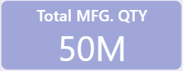
KPI List
Total MFG. QTY – 50M
Represents the total quantity manufactured across all departments.
A key volume indicator showing the scale of production.

Slide 4

Total Rej. QTY – 491K
Total rejected quantity during production.
Indicates areas of quality issues or production errors.

Slide 5

Total Proc. QTY – 60M
Total processed quantity, possibly including both good and rejected units.
Shows throughput across the entire manufacturing cycle.

Slide 6
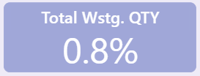
Total Wstg. QTY – 0.8%
Total wastage percentage.
A critical efficiency metric. A wastage of 0.8% is relatively low and suggests efficient material usage.

Slide 7
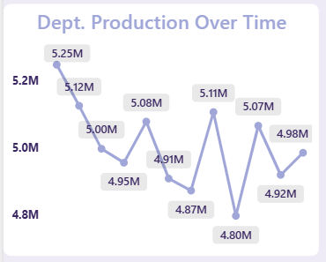
Dept. Production Over Time
Displays monthly production trends by department.
Peak: 5.25M (early in the period)
Low: 4.80M
Shows fluctuations in output, indicating inconsistencies that may need process optimization.

Slide 8
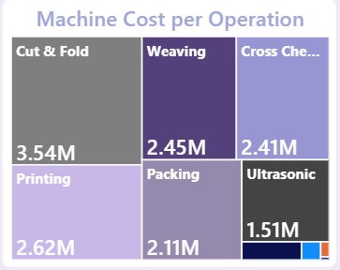
Machine Cost per Operation
Visualizes cost incurred by different machine operations:
Highest: Cut & Fold – 3.54M
Others: Printing (2.62M), Weaving (2.45M), Cross Check (2.41M), Packing (2.11M), Ultrasonic (1.51M)
Helps identify high-cost operations and potential areas for cost-cutting.

Slide 9
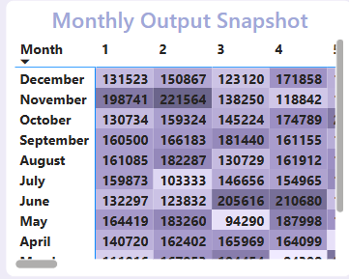
Monthly Output Snapshot
Detailed month-wise output split day-wise.
Useful for comparing productivity trends across time and identifying seasonal patterns or anomalies.

Slide 10
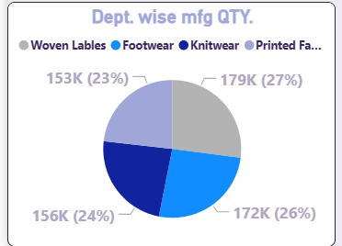
Dept.-wise MFG QTY
Department-wise contribution to manufacturing output:
Footwear: 179K (27%)
Knitwear: 172K (26%)
Printed Fabric: 156K (24%)
Woven Labels: 153K (23%)
Balanced distribution, but footwear leads slightly.

Slide 11
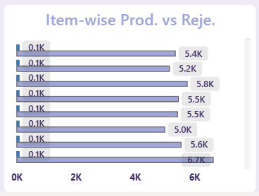
Item-wise Prod. vs Reje.
Compares production quantity vs rejected quantity for each item.
Useful for identifying items with high defect rates (e.g., items with high rejection relative to production).

Slide 12
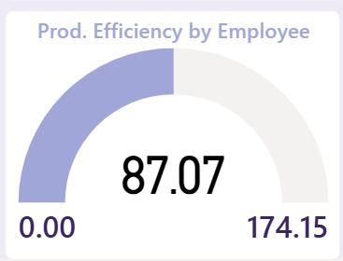
Prod. Efficiency by Employee
Displays employee production efficiency:
Current: 87.07 out of 174.15
This likely represents an average efficiency score, where 100 could be the benchmark.
Shows there's scope for improvement.

Slide 13
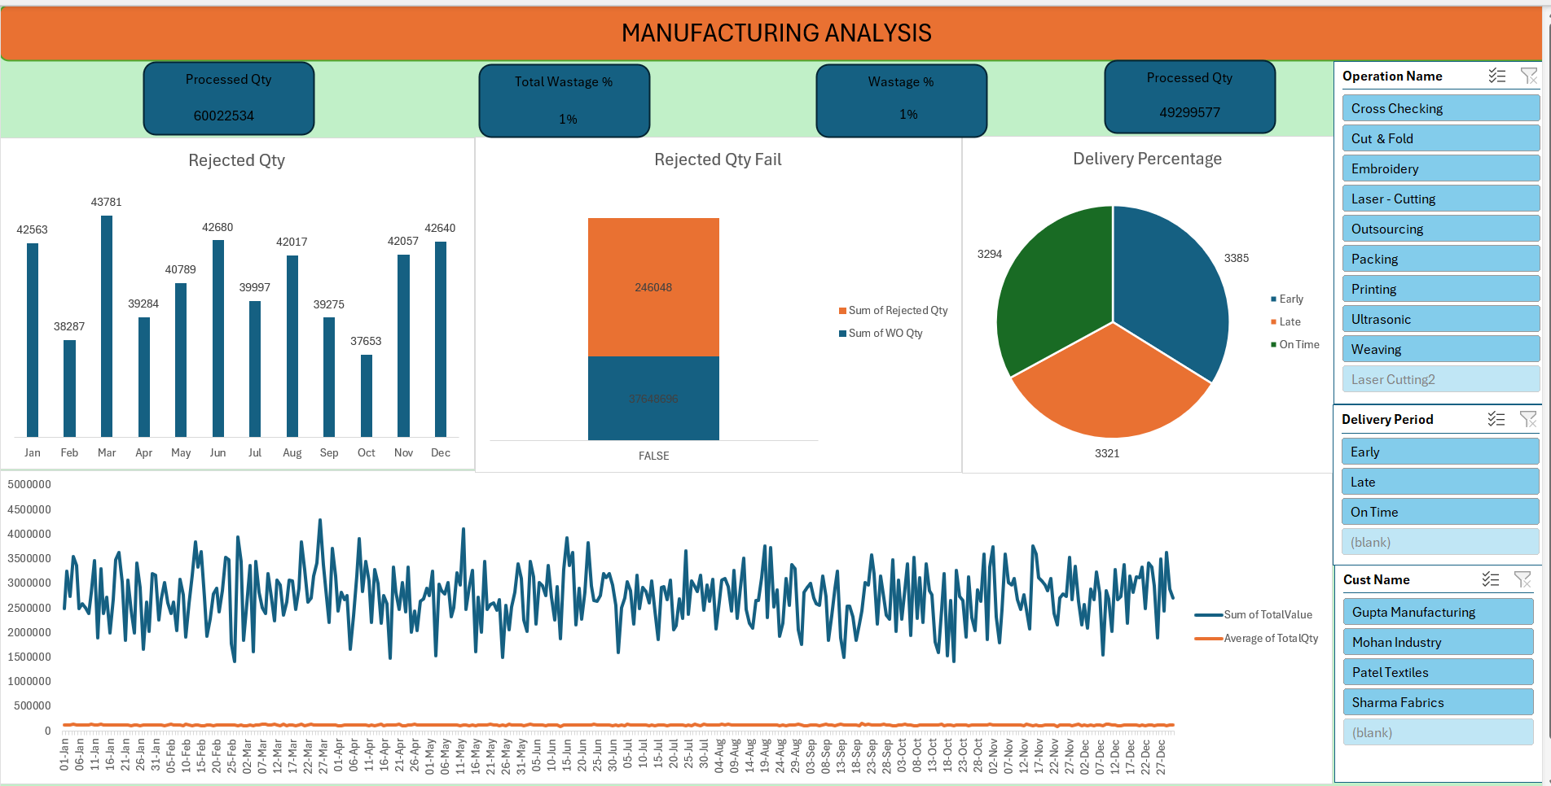
Excel Dashboard

Slide 14
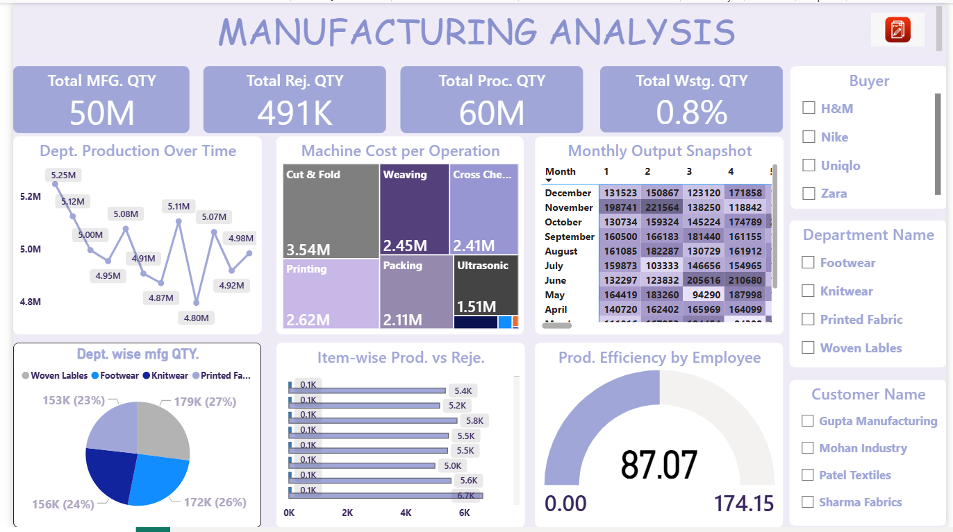
Power BI Dashboard

Slide 15
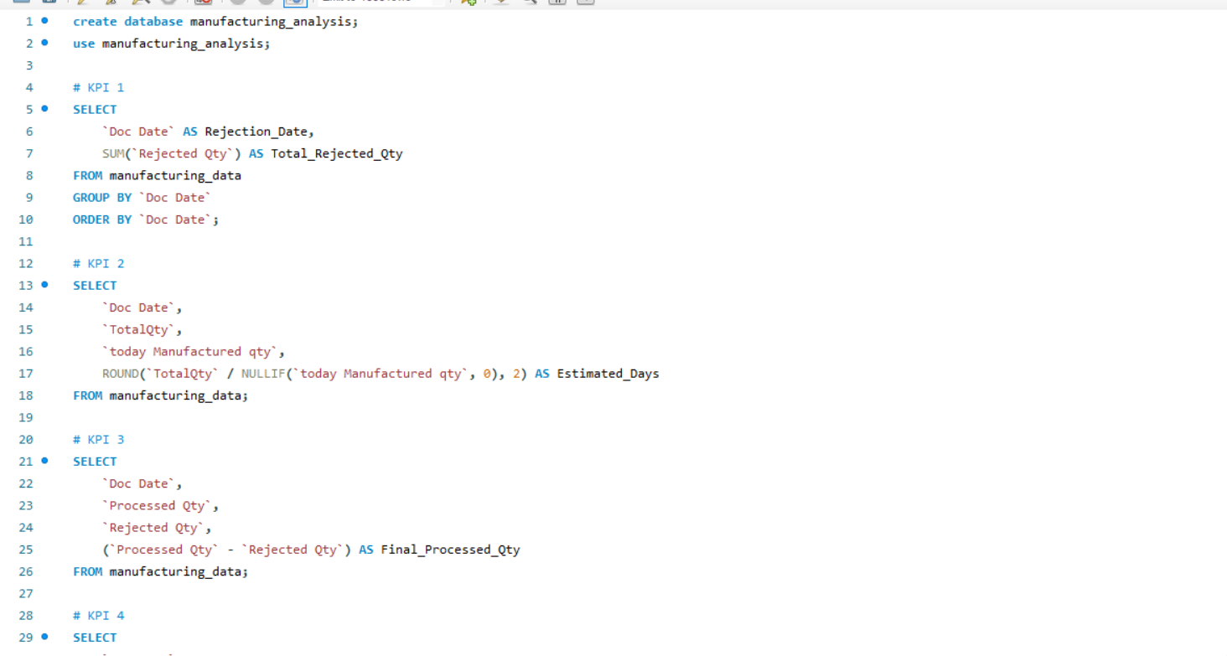
MYSQL Quires

Slide 16
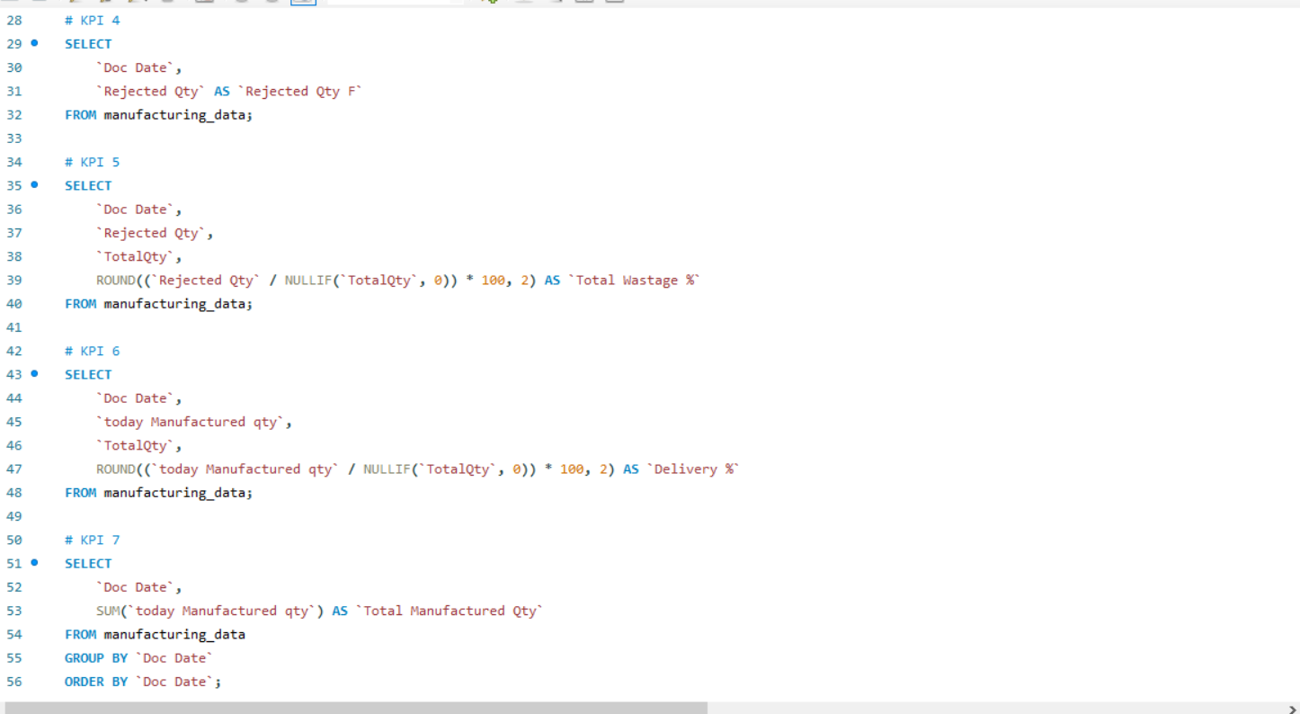

Slide 17
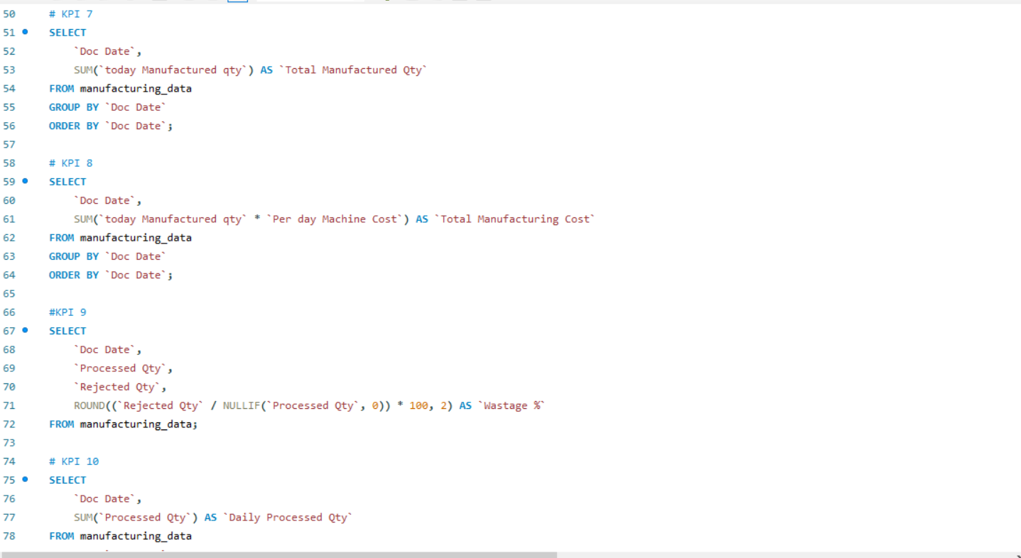

Slide 18
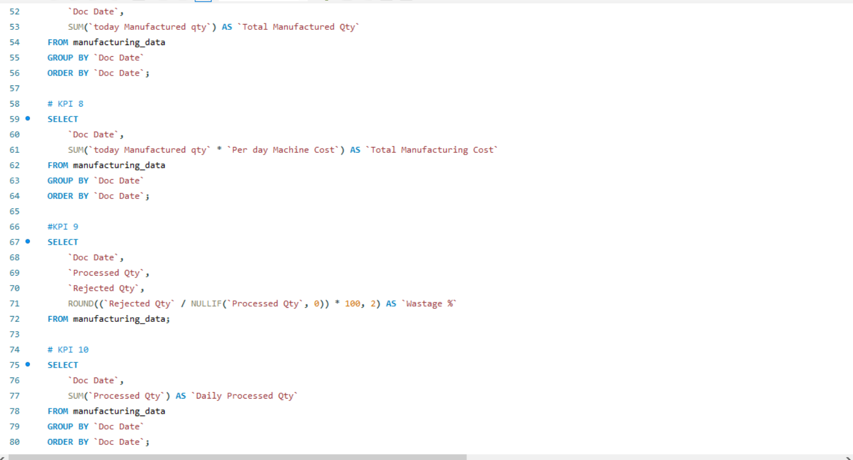

Slide 19
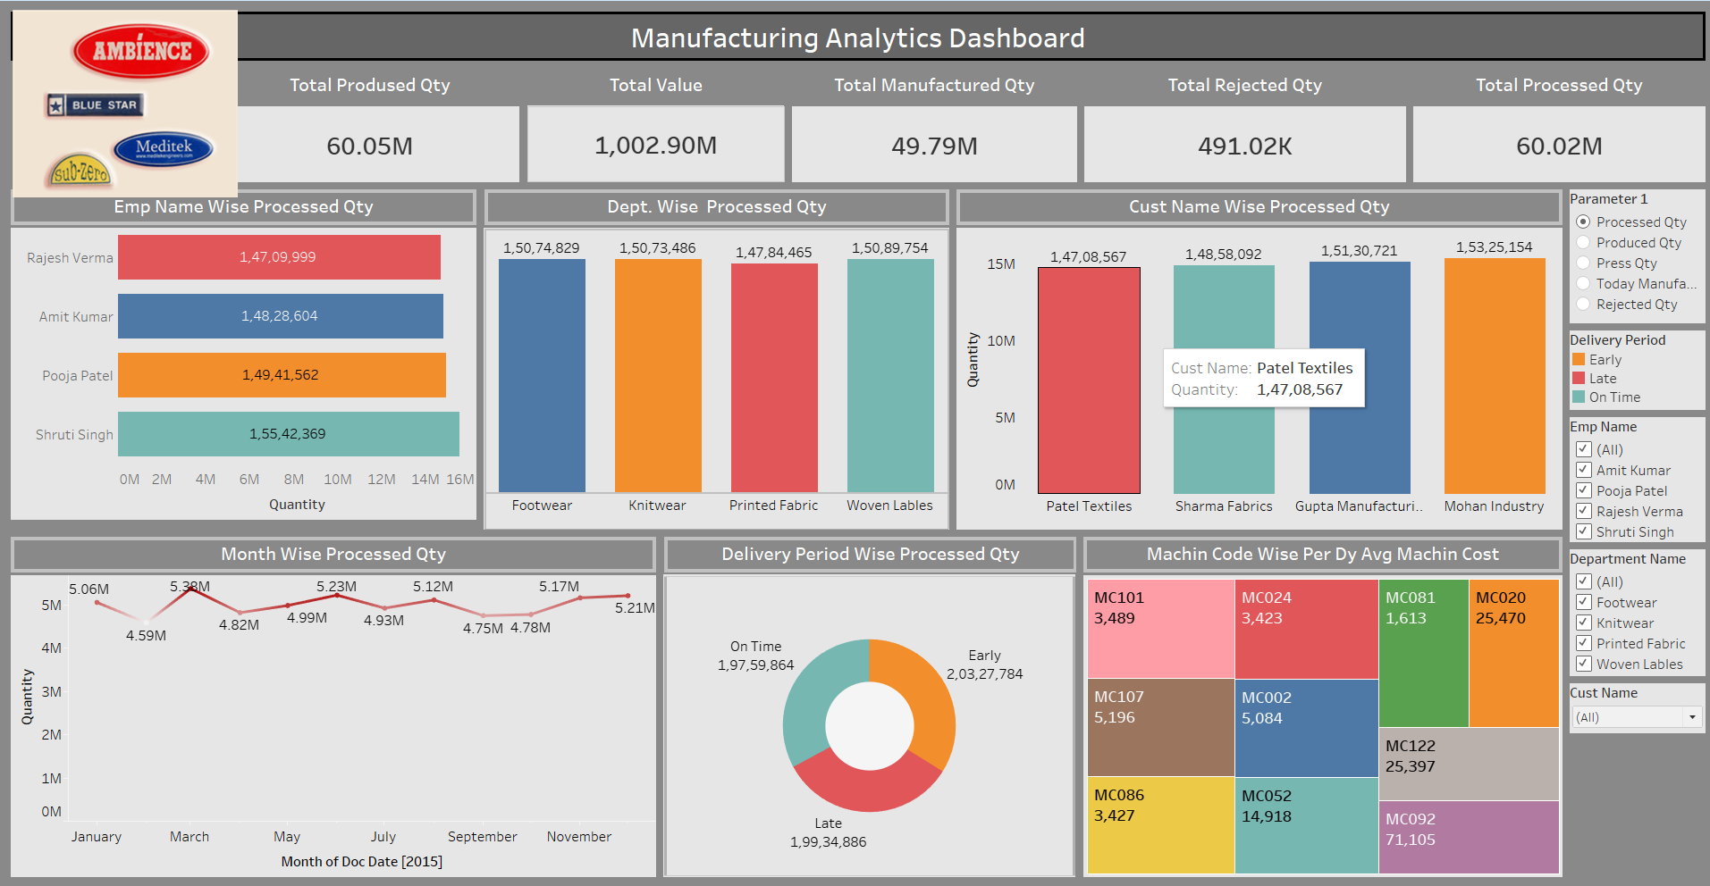
Tableau Dashboard

Slide 20
Key Takeaway
This dashboard provides a comprehensive view of the manufacturing process, covering output volume, cost per operation, efficiency, wastage, and department-level insights. It enables data-driven decision-making by identifying:
High-cost processes.
Production trends.
Efficiency gaps.
Quality issues (through rejections).
Department and item-level performance.

